Slide 1

Organizing Tests and Assertions
Module 5

Slide 2
Why Organize Tests?
Makes tests clean, predictable, and easy to read for everyone
Improves maintainability and makes debugging easier
Supports scalability for larger projects
Enhances collaboration in teams

Slide 3
How to organize tests using AAA pattern?
What is AAA?
A simple and widely-used pattern to structure unit and UI tests for better clarity.
Order | Pattern | Description
1 | Arrange | Set up all necessary test data, mocks, and system state. Prepare everything your test needs.
2 | Act | Perform the action you want to test. e.g., call a method, click a button, submit a form.
3 | Assert | Verify that the outcome is what you expected. Compare actual results with expected results.

Slide 4
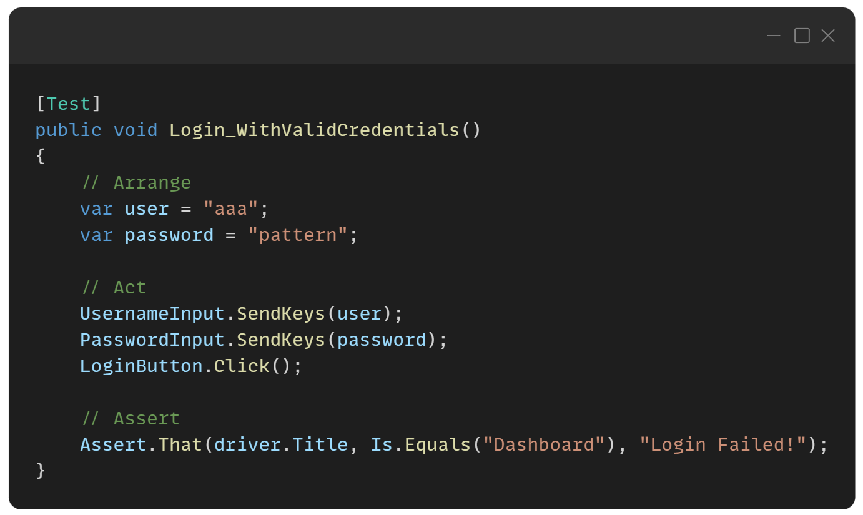
How to organize tests using AAA pattern?

Slide 5
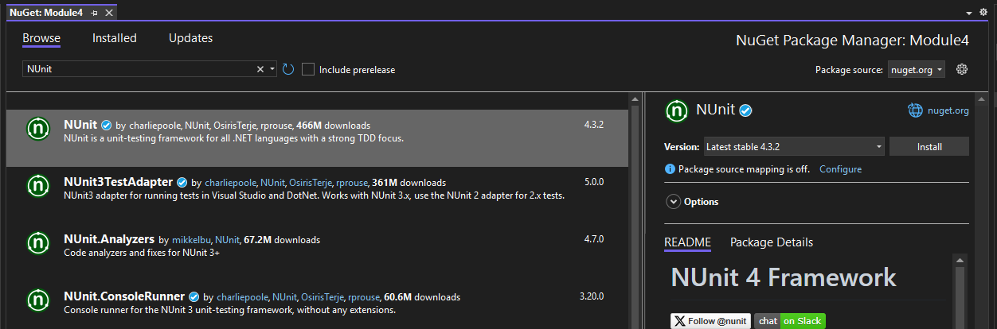
How to organize tests using NUnit?
What is NUnit?
A popular unit-testing framework for .NET applications.
Inspired by JUnit (for Java) — simple and powerful.
Supports parameterized tests, test cases, and categories.
Integrates with popular tools like Visual Studio, Azure DevOps, GitHub Actions, etc.
Detailed reporting for test results and assertion failures.
How to use NUnit
Install NUnit Package
Use NUnit attributes. see next slide

Slide 6
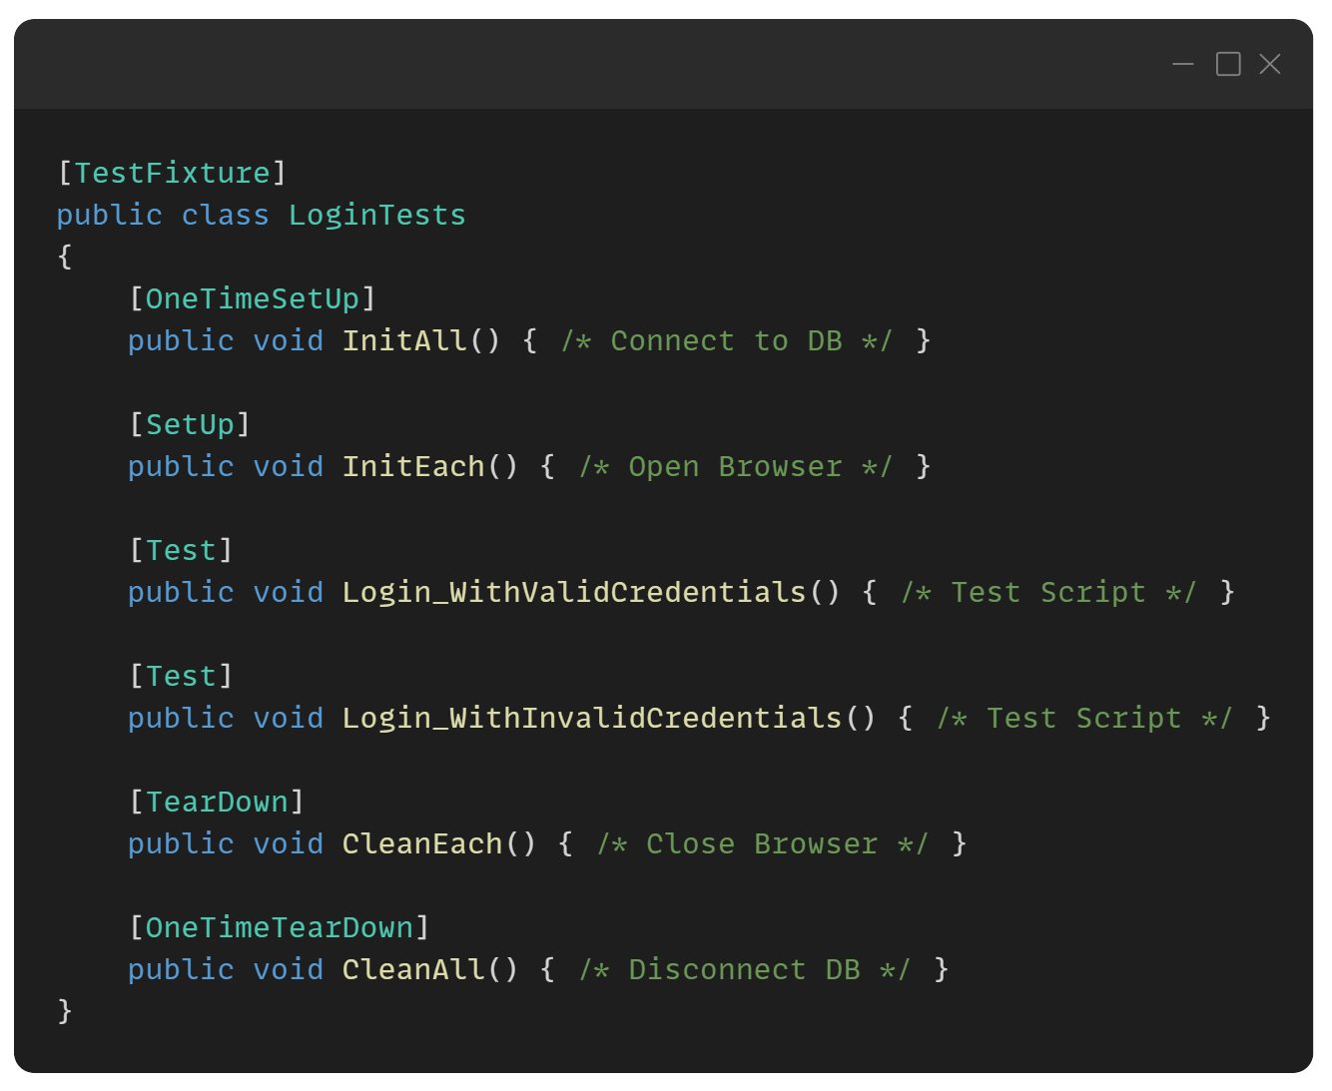
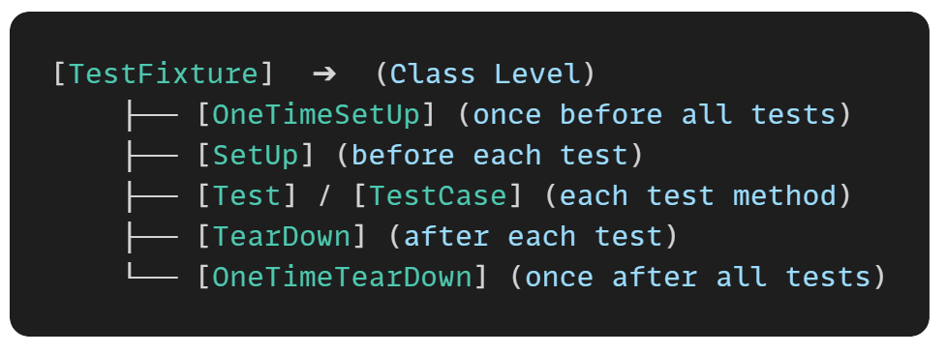
How to organize tests using NUnit?
NUnit Attributes

Slide 7
Assertions using NUnit
What are Assertions?
Assertions check if the output of your code matches the expected result.
They pass the test if true, or fail the test if false.
Assertions make automated testing powerful and reliable.

Slide 8
Using Common Assertions
Purpose | Syntax Example | Meaning
Check equality | Assert.That(actual, Is.EqualTo(expected), “failed comment”); | Are values equal?
Check inequality | Assert.That(actual, Is.Not.EqualTo(unexpected) , “failed comment”); | Are values not equal?
Check true | Assert.That(condition, Is.True, “failed comment”); | Is condition true?
Check false | Assert.That(condition, Is.False, “failed comment”); | Is condition false?
Check null | Assert.That(obj, Is.Null, “failed comment”); | Is object null?
Check not null | Assert.That(obj, Is.Not.Null, “failed comment”); | Is object not null?
Check contain | Assert.That(actual, Does.Contain(expected) , “failed comment”); | Does actual contain expected?
Check contain | Assert.That(actual, Does.Not.Contain(expected) , “failed comment”); | Does actual not contain expected?

Slide 9
Using Common Assertions

Slide 10
Using Assert.Multiple
Allows you to group multiple assertions inside a single block.
All assertions run, and failures are collected together.
Helps when you want full test feedback instead of stopping at the first failure.

Slide 11
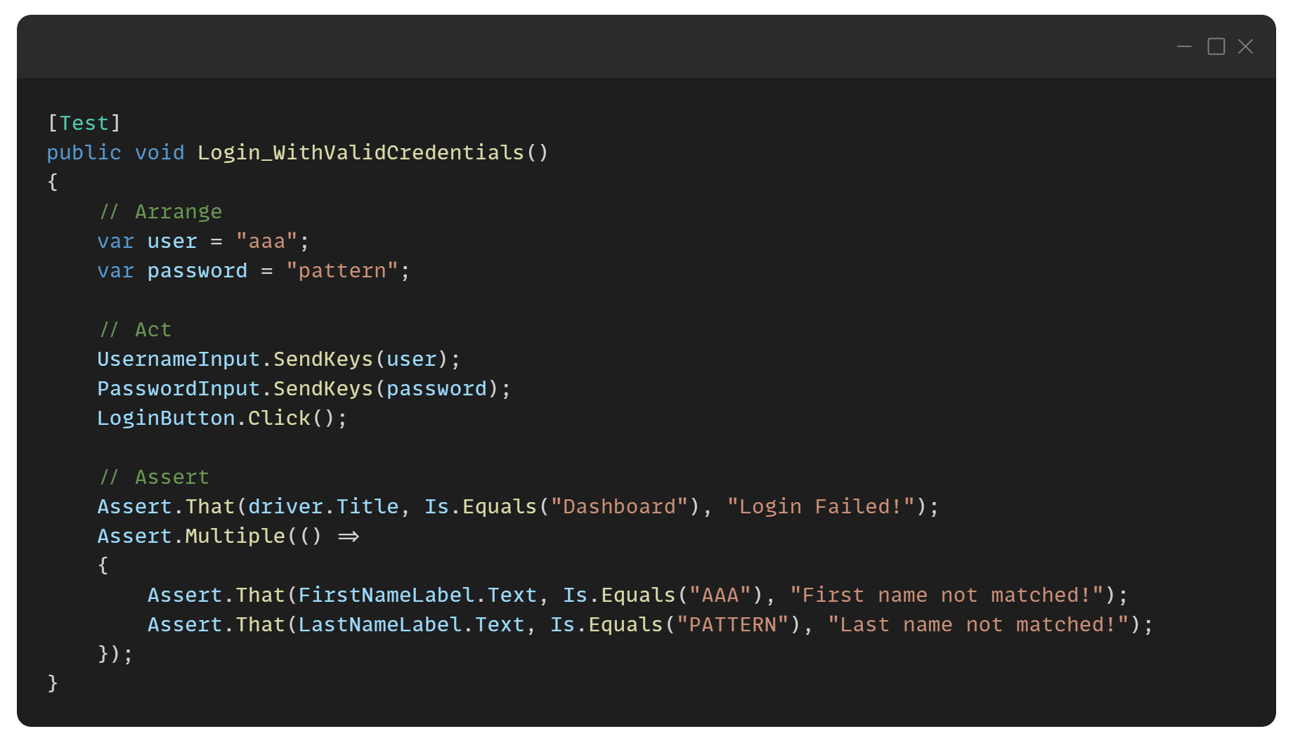
Using Assert.Multiple

Slide 12
Hands-on Activity
Create a new console project named ‘Module5’
Write a selenium script for Test 1 – Successful Login and Test 2 – Failed Login
Use NUnit and Assertion
Use AAA Pattern
Push your code to your GitHub Repo using GitHub Desktop Application

Slide 13
Test 1 – Successful Login
Navigate to URL https://www.saucedemo.com/
Input UserName {standard_user}
Input Password {secret_sauce}
Click Login Button
Check Successful Login

Slide 14
Test 2 – Failed Login
Navigate to URL https://www.saucedemo.com/
Input UserName {locked_out_user}
Input Password {secret_sauce}
Click Login Button
Check Failed Login

